Slide 1
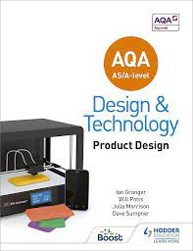
St-Peter’s Design & Technology Department
Product Design Preparation Pack

Slide 2
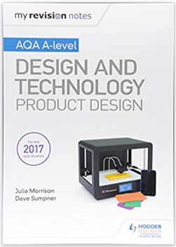
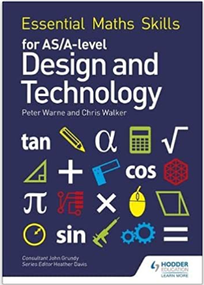
How to use this pack….
This preparation pack is designed to set you up with the basic knowledge and skills to begin your 2 year A-level course in product design. The pack with include a range of exercises which will ask you to conduct research and complete small practical tasks. This should be completed and brought back for your first day of product design. This pack will form the basis of your knowledge and will need to be kept in your product design folder at school.
All work can be done inside the booklet, for design work there is an option to complete work on separate paper and stick it in (this is shown on the pages where this is relevant).
Enough content has been added for you to work around 1hr per week of your summer break. This is sufficient to build the basic skills and knowledge that you need to start the course.
Useful extras….
Should you wish to do some extra reading or to become even more prepared for the start of the course then see below for some places to go, as well as a suggested reading list.
Course textbook (if you don’t wish to buy your own copy, one can be provided digitally at school)
Revision guide to supplement the textbook.
Your course also includes 15% maths and science. This textbook is very helpful on re-capping maths skills that you need.

Slide 3
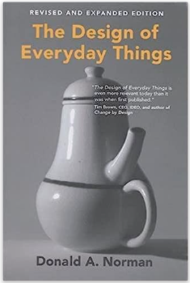
Reading list…
This reading list includes suggestions for books that will help improve your practical and theoretical skills and knowledge.
https://www.amazon.co.uk/Design-Thinking-Understanding-Designers-Think/dp/1350092665/ref=tmm_pap_swatch_0?_encoding=UTF8&qid=1686229900&sr=1-1
“Design thinking” aims to decode the way in which designers think and operate. As an a-level student you will be expected to design independently and creatively.
https://www.amazon.co.uk/Design-Everyday-Things-MIT-Press/dp/0262525674/ref=sr_1_1?crid=1VZ4XXFJGKM00&keywords=the+design+of+everyday+things&qid=1686230377&s=books&sprefix=the+design+of+everyday+things+%2Cstripbooks%2C75&sr=1-1
“The design of everyday things” covers the rationale (and sometimes madness) that comes with the way everyday products are designed. This book heavily focusses on user centred design which you need to know both for you’re a-level exams and for your NEA project.
YouTube Channels…...
Below are some suggestions of good YouTube channels which are full of interesting project ideas and clever tutorials to boost your skills. You may even find some of them used for your practice exercises in this book.
https://www.youtube.com/@One_Day_Video
https://www.youtube.com/@productdesignermaker
Run by New-Zealander, design student Jacob. One day video is a channel which focusses on many areas of design but contains some fantastic how to sketch ideas videos which will boost your design sketching to the next level. v
Product Designer Maker is a channel all specifically for product design students and is crammed with tutorial videos to improve your sketching/ modelling/ idea generating skills.
https://www.youtube.com/@theHacksmith/videos
https://www.youtube.com/@howitsmadeofficial1334
The hacksmith makes videos creating famous props and inventions from movies and tv as well as a lot of crazy other stuff. Here you can find all kinds of inspiration as well as interesting technical information.
How it’s made is a classic late night watch but it is actually filled with all kinds of amazing facts and material knowledge which will prepare you excellently for your exams/ coursework, as well as give you the broad range of knowledge all designers should have.

Slide 4
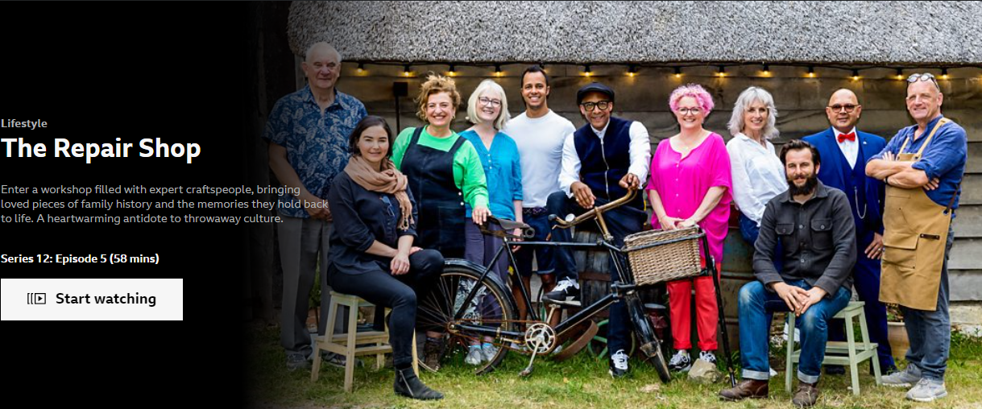
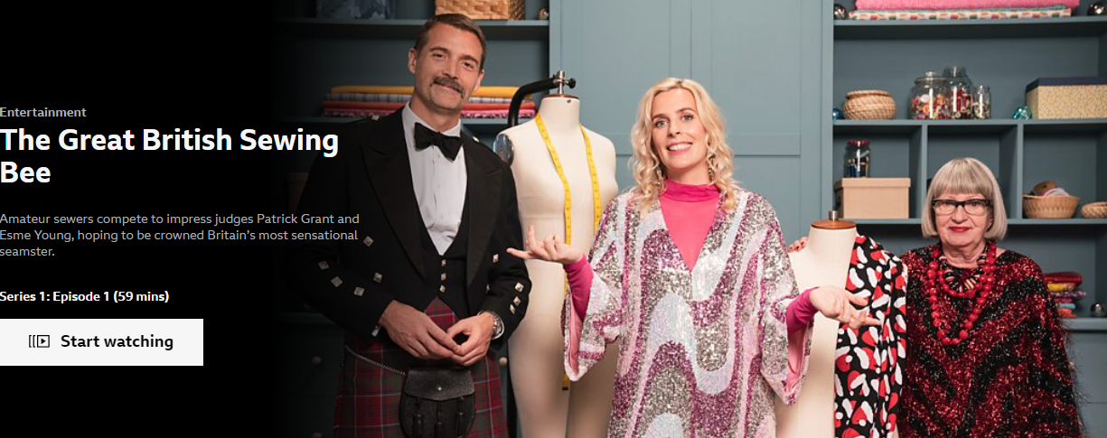
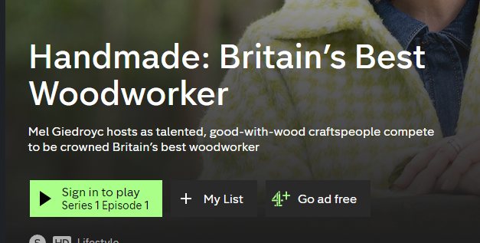
TV shows….
As an A-Level student you should have a real passion for your subject! You can develop this by exploring the subject often. A great way of doing this is to tune into the many making and design shows that are available. Below are some suggestions for some good shows that will inspire you and teach you lots of useful things about designing and making.
“The Repair Shop” on BBC iplayer features members of the public who bring their cherished but damaged items to be restored by a team that work in a wide variety of disciplines and materials. The show features some truly astonishing transformations and will teach you a huge amount about different materials and techniques!
“The Great British Sewing Bee” (BBC iplayer) is a bake-off style show which takes amateur sewers from all walks of life and pits them against each other to be crowned Britain's best sewer. This show features lots of creative challenges and teaches plenty, especially focussing on re-making and sustainability.
“Britain’s Best Woodworker” (channel 4/ 4oD) is another bake-off style show which similar to sewing bee aims to find Britain's best woodworker. This show will teach you lots of excellent technical knowledge to improve your making knowledge.
“Abstract- the art of design” (Netflix) is a documentary covering a huge variety of stories of different areas of design from graphic design to toy design and stage design for music and theatre. This series is excellent for teaching you the process and thoughts behind what designers do. For product design students the toy design episode is especially recommended!

Slide 5
Chapter 1- Sketching Skills
To start this chapter, I would like to remind you that the ability to produce incredible and exactly lifelike pieces of artwork, are NOT a requirement to study product design. Students often worry that their drawing and sketching skills are poor and therefore so is there design work. This is however not the case. The ability to sketch well is of course a great skill to have, but at the core of sketching in product design is communication. We draw and sketch to communicate our ideas to people, and although obviously technique is important, the main focus on this chapter is to teach you to communicate through your sketching, and to have the confidence to sketch an idea whenever you have one.
Task 1- freehand sketching. Follow the YouTube tutorials and fill the next few pages with sketches. There should be no space left on the paper! Start by sketching random shapes and forms, then move onto sketching everyday objects.
Video 1 - https://www.youtube.com/watch?v=UbFMSV-BLS0
Video 2- https://www.youtube.com/watch?v=0GYRJlreYtA
Video 3- https://www.youtube.com/watch?v=IaPwhWBj77o
Video 4- https://www.youtube.com/watch?v=KzSrML9lwPQ

Slide 6
Sketching space…...

Slide 7
Sketching space…...

Slide 8
Sketching space…...

Slide 9
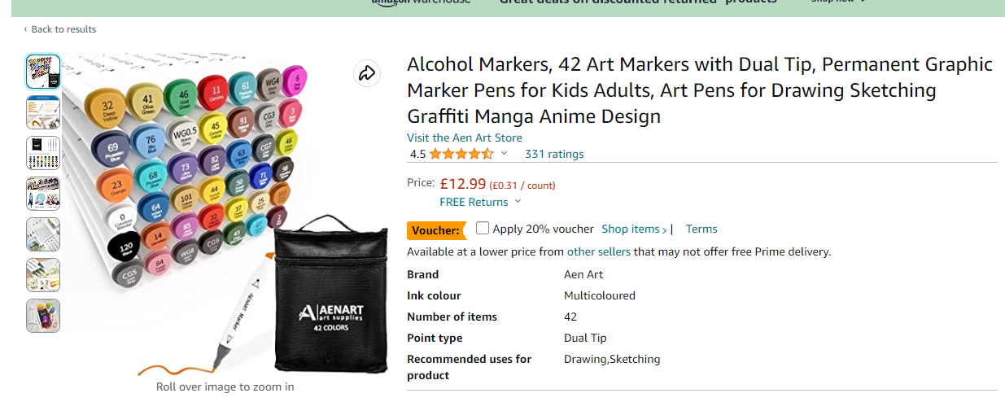
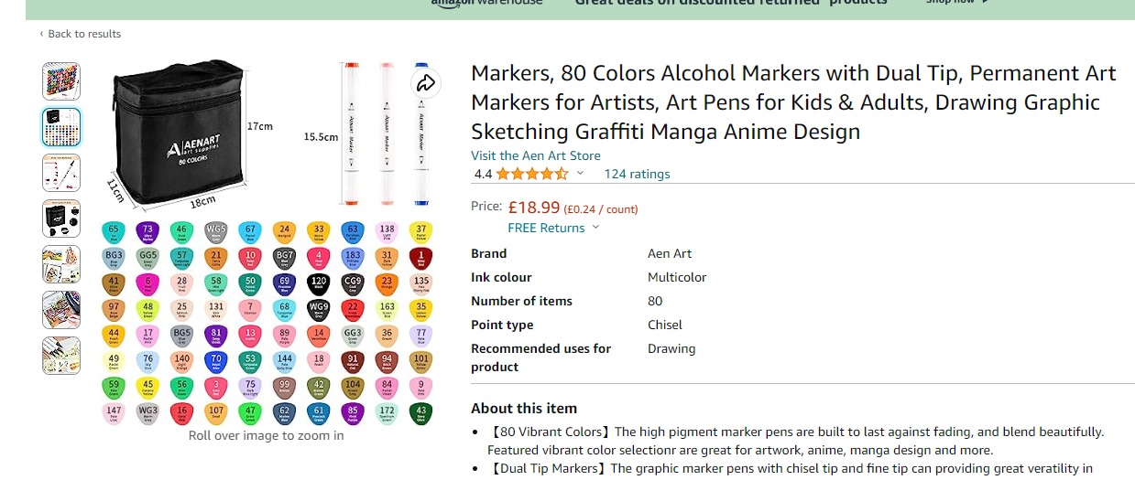
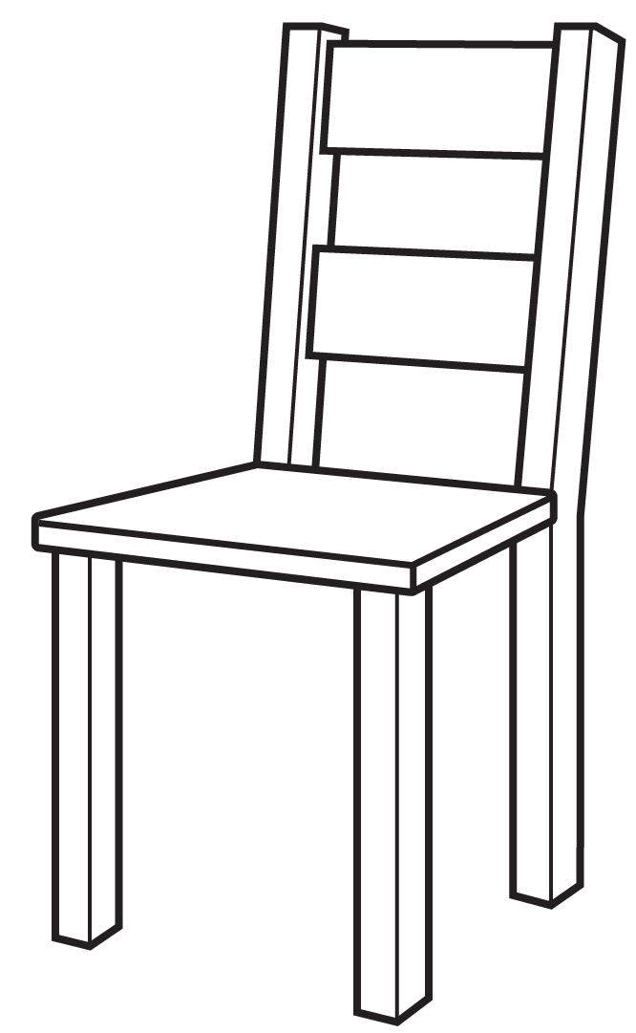
Chapter 2- Rendering Skills
Rendering is the skill of adding texture, light and material effects to your sketch work. As with the previous chapter this skill will enable you to communicate with sketching to the best of your ability. You will eventually be able to communicate intended materials in a design, as well as to aid in communicating the shape/form and texture of surface e.g. shiny or mat surfaces. The tutorials below will help you do this.
To achieve rendering you can use colouring pencils but if you want to invest in something a little more professional you can use design markers. These can be found relatively cheaply on amazon or in art shops (see links below) . Be careful that these can bleed on regular paper so you may want to use a separate piece of paper and stick it into this booklet.
As with the last chapter, fill the next few spaces with rendered sketches. This is a good opportunity to also practice your sketching skills again!
Note- Although some of the videos below are done with design markers, the same process can be achieved with coloured pencil. All that is needed is to use shading to achieve the same effect.
Video 1- https://www.youtube.com/watch?v=yN9rFrf6CHc
Video 2- https://www.youtube.com/watch?v=jouns7hQnX8
Video 3- https://www.youtube.com/watch?v=wF8rXqHLDlg
Top tip- If you find the sketching and rendering hard. Find some simple line drawings on google images to get started. Render on top of them and then when you feel more confident you can then render some sketches that you have drawn.

Slide 10
Sketching and rendering space…..

Slide 11
Sketching and rendering space…..

Slide 12
Sketching and rendering space…..

Slide 13
Sketching and rendering space…..

Slide 14
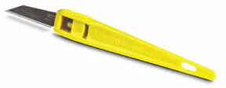
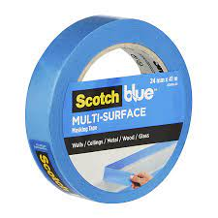
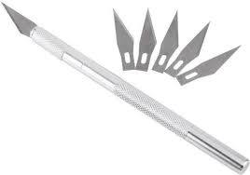
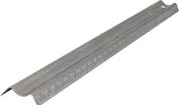
Chapter 3- Modelling Skills
Modelling the is the next in our key set of skills As you will learn throughout the course, modelling is a crucial stage in any project. It allows us to take our ideas from the virtual imaginary world of our brains (through sketching) into the real world where we can look at them, hold them and use them first hand, in order to find out what does and doesn’t work about it. They also allow our client to do the same (remembering that designers work for other people rather than themselves).
Video 1 - https://www.youtube.com/watch?v=mV03Si13_co
Video 2- https://www.youtube.com/watch?v=9xHAbRAXBko
Practice tutorials
Video 3- https://www.youtube.com/watch?v=nNLY1yt9iCE
Video 4- https://www.youtube.com/watch?v=x6s3lGH4MyI
Video 5- https://www.youtube.com/watch?v=Msd0dmfEpMg
Main task
Add photos of your modelling to the next few pages as a record of what you have done. Materials for this chapter are just simple cardboard, ideally corrugated cardboard.. This can be found all over the home or can be bought fresh from places such as hobby craft or amazon. Below are the suggested tools and equipment you will need:
Craft knife. There are many options here. The standard “Stanley knife” is good but some people prefer the “xacto” knife which has replaceable blades.
PVA glue. Try to get a small bottle with a fine nozzle. This will allow you to add glue to small areas.
Painter’s tape- This is similar to masing tape (which can still be used if you can’t get painter’s tape) but is a little stronger and will hold glued joints well while it dries.
Safety rule- This can be a steel rule but the point is whatever you use to guide your cutting you need to use a metal object. This is to protect your fingers should you slip with your craft knife.

Slide 15
Modelling photos…..

Slide 16
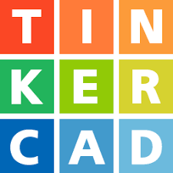
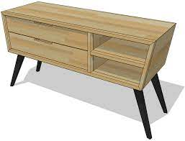
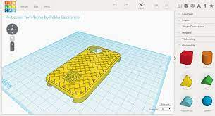
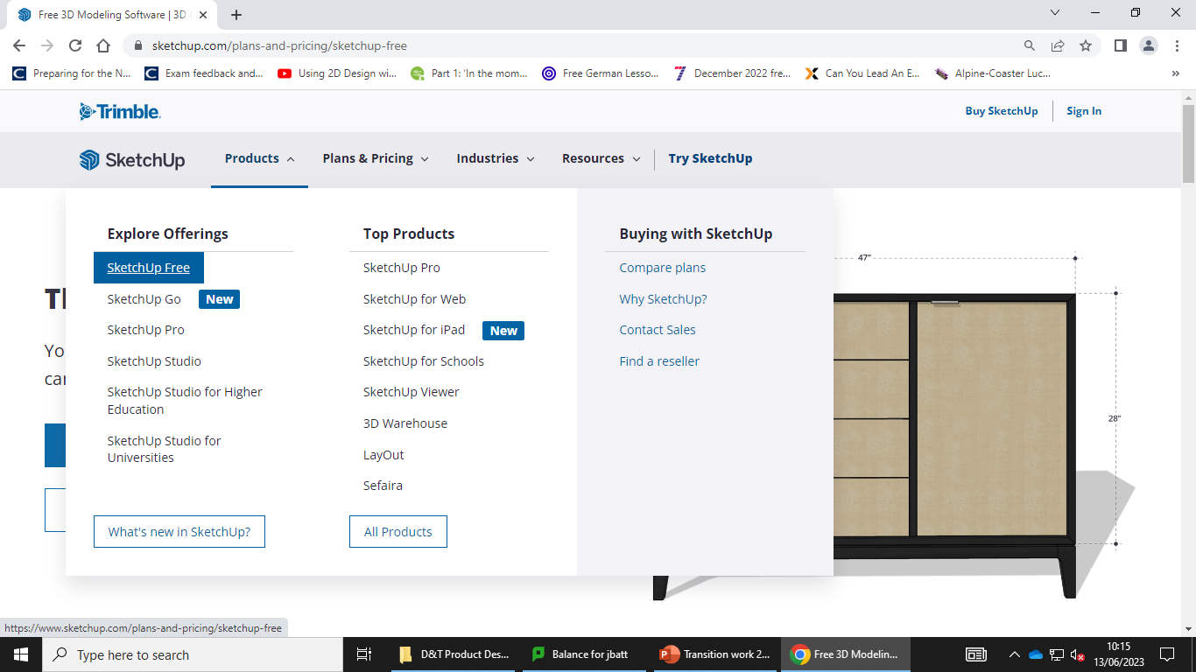
Chapter 4- CAD skills
As much as sketching is our bread and butter in terms of design communication, CAD (computer aided design) is where we get fancy and take our communication to the next level by adding digital rendering and creating highly accurate technical drawings toa id construction. The extra bonus is that with some CAD we can use it to actually make things too.
To do this you will be using some free software which can be accessed online. You won’t need to download anything to use it and you will be able to access your work anywhere with a laptop and internet connection. The two softwares you will use are: Sketchup (free version) this is a globally popular 3D design software which will allow you to create rendered accurate 3D models of your designs. This will allow you to prototype quickly and show your designs as they will be in real life. The second is Tinker CAD. This is produced by a company called Autodesk. Autodesk are the world leader in CAD software for professional industry, this software is free and designed for 3D printing. Below are your instructions to get started and practice.
To use Sketchup Free you need to make an account. To do this follow the steps below using your school email. Avoid giving any personal information that is not compulsory.
Similarly with Tinker CAD you will need to make a free account. Make sure to sign up as an induvial rather than a student.
Exercise- https://www.youtube.com/watch?v=zpdMZK6LlDE
Things to watch! In the video you will see imperial units used (feet and inches) however in the UK we use Millimetres. Your SketchUp should be set to MM automatically, when it comes to following videos use your own estimate dimensions or pause and convert using google.
Tinker CAD comes with it’s own tutorials. Once logged in look for them on the right hand side (these may appear when you log in for the first time).
Complete all of the tutorials as your exercise for this software.

Slide 17
CAD work page…….
Add screenshots of your finished CAD work here.

Slide 18
Chapter 5- Materials/ Manufacture Knowledge
Being able to design things is all well and good, but if we have no idea what from or how to make them we may as well stop. In this chapter you will develop and cement your basic knowledge. This is especially important if you have not studied GCSE D&T as you will need to catch up on the base knowledge that previous D&T students have.
TASK 1- Complete the grid below to explain the key terms. Find the definitions or the origin of these materials.
Material/material type | Origin of material | Definition (if appropriate)
Smart Materials
Modern Materials
Composite materials
Bioplastics
Polymers
Synthetic
Thermosetting polymers
Thermoforming polymers
MDF
Plywood
Allloy
Ferrous Metal
Non- Ferrous Metal

Slide 19
Materials and manufacture knowledge- Video 1 Watch the video below, while watching take screen shots to explain: What materials are being investigated; what are the properties of these materials; why have/are these materials being used? https://www.youtube.com/watch?v=SswtSlIY8zU&list=PLtJQIEsm-mu0KK9R66WXEItrQeViA795l

Slide 20
Materials and manufacture knowledge- Video 2 Watch the video below, while watching take screen shots to explain: What materials are being investigated; what are the properties of these materials; why have/are these materials being used? https://www.youtube.com/watch?v=8UwjncjLd-Y&list=PLtJQIEsm-mu0KK9R66WXEItrQeViA795l&index=5

Slide 21
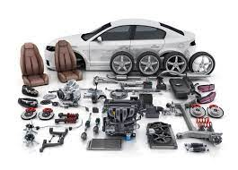
Chapter 6- Research Skills
Being able to conduct research properly with depth is a skill many people think they have but rarely know how to do correctly and independently. In this chapter you will learn how to conduct research to the level needed to study an A-level. The videos and exercises included will teach you to think to that level, and identify what kinds of research you can carry out in a design project, in order to find what you are looking for!
How to research properly, the basics!
Ask the right questions! So many students rely on only google for the answers to all their questions. And problems. But you have to ask the right question and read the information you are given. Go into website and read for the info you need. Don’t assume google will give it to you on a plate!
Don’t be scared of reading an actual book! Sometimes to get our head around key concepts finding a detailed book and reading it thoroughly is the answer.
At A-level you should be reading around the subject often!
Don’t use Wikipedia, as an a-level student Wikipedia should be long gone. Wikipedia is edited by members of the public and therefore is liable to be wrong. Find the right official or professional sources of information where you can.
Find relevant information! So many GCSE students find random facts online which come from countries and societies which are totally unrelated to their project. If you live in the UK and are gathering information on a problem based in the UK find facts from the UK! US facts tend to dominate google so make sure to find facts from the society that is relevant to you!. And your project.
Use real life as much as you can! At A-level you are expected to make use of primary (first hand) research as much as possible. So when you need the answer to a question find someone who can help you for real. This is also teaching you the great skill of networking which you will need in the future. Designers work in teams so working with others is a must. Also make use of studying and taking things apart to find out how things work and how to build things for yourself. Conduct surveys to find out your target market’s opinion and gather thoughts from lots of people at once.

Slide 22
Research tasks…..
1. Question video- https://www.youtube.com/watch?v=FbYx8Agg2z0
Sketching and modelling
Manufacturing main prototype
Testing and review
Start
Watch the video and on the timeline above, annotate to explain what kind of research tasks a designer would be doing at the stages along the line.
2. Asking the right questions. To practice this skill you have been given a design topic and context below. Your task is to conduct some research on the following pages to learn as much as possible about it. You should fill all of the space you can.
How much of this research can you do first hand with: interviews; product testing and analysis; conducting a survey, going out into the street to look for information, asking real people.
Context- “Obesity and the body”. Obesity is becoming a large issue in today’s UK society which is having further consequences on people’s health and fitness.
Conduct as much research as you can and answer the questions at the end of this chapter.

Slide 23
Research tasks…..

Slide 24
Research tasks…..

Slide 25
Research tasks…..
End of Research Key questions
Why do people become obese?
What effects are there on the body as a result?
What are the effects for the wider UK society of obesity?
What is needed to solve the problem?
Now sketch a product/range of products that could help this problem (render your ideas).

