Slide 1

BTEC Applied Science
Transition from year 11 to year 12
BTEC applied science will develop your understanding of the fundamentals of science (unit 1) and your ability to complete effective investigations following the scientific method (unit 2 and 3).
To succeed in applied science you will need to be able to:
Remain organised and meet deadlines (this is a complex course with both internal and external aspects.
Respond effectively to feedback
Demonstrate resilience and use initiative to seek help.
This booklet is split into 2 sections that will help prepare you for the start of year 12.
Section 1 – fundamental science | Section 2 – practical competency
Biology Chemistry Physics | A specific focus on scientific method and the importance of variables

Slide 2

BTEC Applied Science
But first… Why science?
What skills does science develop?
Select a career (it may be one that you wish to pursue or at least try out). How would a scientific approach help you in that career?

Slide 3
BTEC Applied Science
Section 1
The fundamentals of Biology
Magnification:
Complete the worksheet on the following slides to using the equation:
Image size = Actual size x Magnification
Cells:
Research a eukaryotic cell and label the:
Plasma membrane, cytoplasm, nucleus, nucleolus, endoplasmic reticulum, golgi apparatus, vesicles, lysosomes, 80S ribosomes and mitochondria
Nervous Tissue:
Create a comic strip/still motion for the action of a neurotransmitter (e.g. acetylcholine) at a synapse

Slide 4
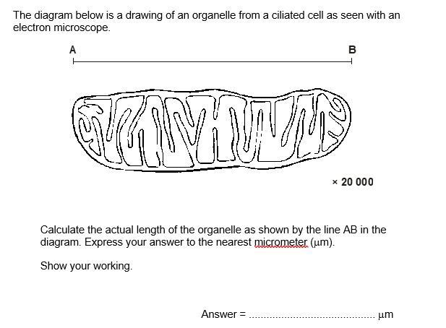
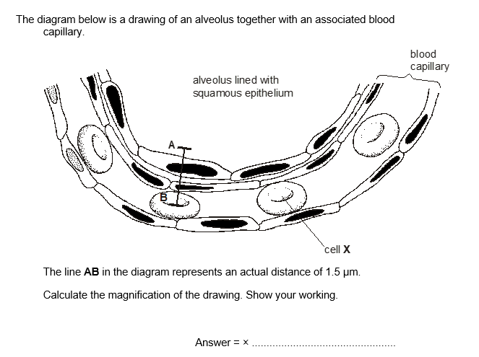
BTEC Applied Science
Section 1

Slide 5
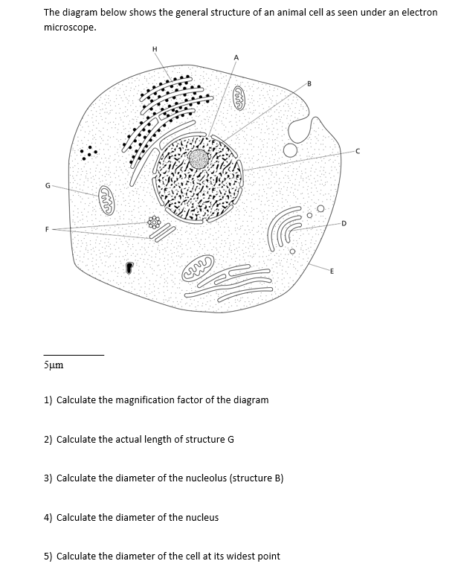
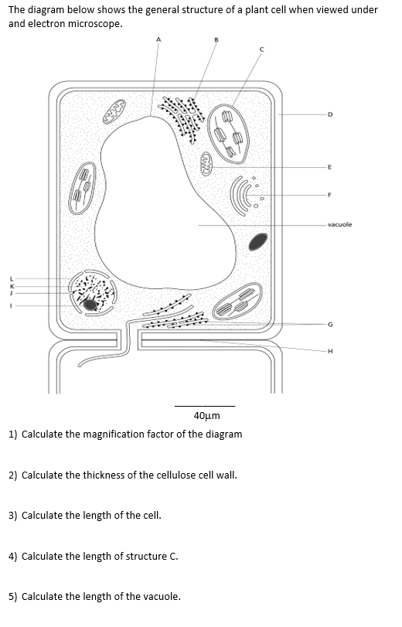
BTEC Applied Science
Section 1

Slide 6
BTEC Applied Science
Section 2
The fundamentals of Chemistry
Task 1: Draw the electronic structure of the element in the box, remember the rule 2, 8, 8
Carbon – 6 electrons | Oxygen – 8 electrons | Calcium – 20 electrons | Ne – 18 electrons
https://www.youtube.com/watch?v=yADrWdNTWEc
Task 2: Use a Periodic Table to complete the table below.
https://www.youtube.com/watch?v=GyJBstOn4t4
Atom or Ion | Atomic Number | Mass number | Number of protons | Number of neutrons | Number of electrons | Electron Structure
¹⁶O²⁻ | 8 | 16 | 8 | 8 | 10 | (2,8)²⁻
³¹P
 | 13 | 27 |  |  | 13
 | 13 | 27 |  |  | 10
³²S²⁻
 |  |  | 12 | 12 |  | (2,8)²⁺

Slide 7
BTEC Applied Science
Section 2
The fundamentals of Chemistry
Positive Ions |  | Negative Ions
Group 1 Ions: Lithium Li⁺ Sodium Na⁺ Group 2 Ions Magnesium Mg²⁺ Calcium Ca²⁺ | Group 3 Ions: Aluminium Al³⁺ Other Common Ions Silver Ag⁺ Zinc Zn²⁺ Hydrogen H⁺ Ammonium NH₄⁺ | Group 7 ions: Fluoride F⁻ Chloride Cl⁻ Group 6 Ions Oxide O²⁻ Sulfide S²⁻ | Other Common Ions: Nitrate NO₃⁻ Sulfate SO₄²⁻ Carbonate CO₃²⁻ Hydrogencarbonate HCO₃⁻ Hydroxide OH⁻
https://www.youtube.com/watch?v=URc75hoKGLY
https://www.youtube.com/watch?v=p9iQ5Qn42DM
Task 3: Write the formula below for these substances (you will need to use the table and a Periodic Table)
Silver Bromide ………………………..
Sodium Carbonate ………………………..
Potassium Oxide ………………………..
Iron (III) Oxide ………………………..
Chromium (III) Chloride ………………………..
Calcium Hydroxide ………………………..
Lead (I) Oxide ………………………..
Rubidium Carbonate ………………………..
Zinc Hydrogencarbonate ………………………..
Ammonium Sulfate ………………………..
Gallium Hydroxide ………………………..
Strontium Selenide ………………………..

Slide 8
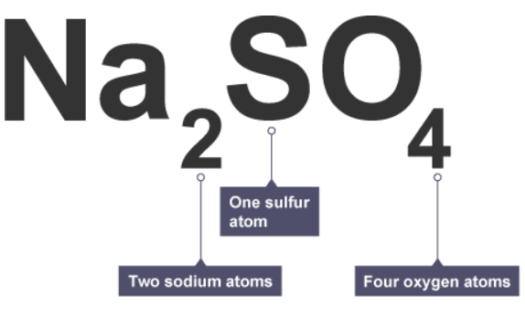
BTEC Applied Science
Section 2
The fundamentals of Chemistry
Chemical formula tell you the number (or ratio) of atoms present in a substance. We can read formula by following a few rules:
Read formula like English sentences: each new sentence starts with a capital letter (check out the Na₂ below)
The number after the chemical symbol is the number of the atoms of the previous element (check out the O below)
If there is no number this is the same as 1 (check out the S below)
Remember you can find what the symbol means by using the Periodic Table in your planners
Calculate the Relative Formula mass by adding the mass number of each of the atoms present (remember the mass number is the larger number on the Periodic Table
 | Atoms | Atoms | Atoms | Relative Formula Mass
Na₂CO₃ | 2 Sodium | 1 Carbon | 3 Oxygen | (2x23) + 12 + (3x16) = 106
H₂SO₄
HNO₃
Al₂O₃
FeO
NaOH
ZnSO₄
Na₂O
NaBr
Li₃PO₄
 | 3 hydrogen | 1 phosphorous | 4 oxygen
 | 2 carbon | 6 hydrogen | 1 oxygen
 | 1 calcium | 2 oxygen | 2 hydrogen
 | 2 lead | 1 oxygen

Slide 9
BTEC Applied Science
Section 3
The fundamentals of Physics
Wave Equation
Calculate the following:
The speed of a wave with a frequency of 10kHz and a wavelength of 2m.
The speed of a wave with a wavelength of 50cm and a frequency of 4kHz
The frequency of a wave travelling at 500m/s with a wavelength of 25m
The speed of a radio wave with a wavelength of 3000m and a frequency of 100kHz
The speed of a wave with a frequency of 30MHz and wavelength of 10m
The wavelength of a wave travelling at 11km/s with a frequency of 5.5kHz
The frequency of the wave below, which is travelling at 9km/s
Wave Features
Use the wave equation below to answer the questions
Wavespeed (m/s) = frequency (Hz) x wavelength (m)
Draw a diagram of a transverse wave
(e.g. light) and a longitudinal wave
(e.g. sound).
Label your diagrams with the following:
Amplitude
Wavelength
Crest
Rarefaction
Compression
Crest
Trough
Waves in music
Research a musical instrument and describe how it demonstrates the principles of waves

Slide 10
Section 2 – practical competency
Science investigations are achieved by accurately observing what happens when one adjustment is made. Of course we want to only see the impact of one change at a time, otherwise we don’t know which change causes the effect.
Here are some terms you need to be familiar with:
Variable = Something (anything!) which can vary/be adjusted
Independent variable = Something that is investigated by changing it and seeing the effect
Dependent variable = The thing that can vary as an effect, this is recorded in a results table
Control variables = Variables which must be kept the same because otherwise they will effect the dependent variable (results)

Slide 11




Section 2 – practical competency
Determining Variables
Ed wants to calculate the time it takes for his acoustic guitar to need to be retuned compared to his electric guitar. He plays the acoustic guitar for 30 minutes, and then checks the tuning. He continues this until each string is out of tune. He repeats this with the electric guitar.
He then repeated the investigation 2 more times and calculated an average.
In an investigation, Ryan wanted to identify the time it takes for him to run different distances.
One day, he ran 200 meters just after breakfast.
On day two, he ran 1.5km just after he woke up.
On day 3, he ran 100 m after dinner.
On day 4, he ran 12km just after waking up.
Independent Variable =
Dependent Variable =
Control Variable =
Independent Variable =
Dependent Variable =
Control Variable =
In an investigation, Rishi decided he wants to identify the metal that transferred heat through it fastest when he placed one end into hot water and held onto the other. For iron, he placed it in 100ºC water, for copper, he placed it in 50ºC and for Zinc, he placed it in 30ºC. He timed how long it took for his hand to feel the heat.
Taylor thinks that a special juice will increase the memory of her backup dancers. She creates two groups of 10 dancers each and assigns each group the same task (learn a new dance)
Group A is given the special juice to drink while they work.
Group B is not given the special juice.
After an hour, counts an average of how many steps each group has learned.
Independent Variable =
Dependent Variable =
Control Variable =
Independent Variable =
Dependent Variable =
Control Variable =

Slide 12
Section 2 – practical competency
Completing an investigation following the scientific method
Identify something to investigate at home (remember the scientific method can be applied to any investigation).
Create a hypothesis: What do you predict will happen when you change just one thing
Determine the variables.
Create a valid method – where the control variables are kept the same and so only one variable (the independent) can affect the results (the dependent variable)
Complete your investigation and collect the results
Create a conclusion
If you are stuck for ideas. How about one of these:
The mass of butter used in a cheese toastie affects it’s enjoyment!
The temperature of water affects the mass of sugar that can be dissolved in it

